Slide 1

Title Slide
Project Name: [Hostel Complaint Management System]
Team Name: [Dr.C.N.Rao]
Problem Statement ID: [PS 11 ]
Problem Statement Overview :
[Hostel Complaint & Maintenance Tracking System (Student-Warden Portal) :
Build a web-based system to manage hostel-related complaints and maintenance requests in a structured and transparent way. Students should be able to raise complaints (e.g., plumbing, electricity, cleanliness, internet, room issues), track their status, and provide feedback after resolution. Wardens/maintenance teams should be able to view and manage all complaints, prioritize them, assign tasks to staff, and monitor pending or overdue issues. The platform must support a clear workflow for complaint handling (e.g., Submitted → Assigned → In Progress → Resolved/Closed), enable priority-based handling (Low/Medium/High), and provide basic analytics to help hostel administration identify recurring issues, resolution time patterns, and backlog/overdue trends. ]
Solution Overview:
[A comprehensive, web-based Hostel Complaint & Maintenance Tracking System featuring role-based dashboards, real-time messaging, transparent complaint tracking, and detailed analytics to streamline hostel maintenance operations and improve student satisfaction.]
Page 1

Slide 2
Solution Details
Proposed Solution • A modern, responsive web application with separate portals for students and wardens • Structured complaint workflow with real-time status tracking and priority management • Integrated messaging system for transparent communication between students and staff • Analytics dashboard for identifying patterns and improving response times • Minimalist design with intuitive user interface for ease of use
• The system provides students with a platform to submit complaints across multiple categories (plumbing, electricity, cleanliness, internet, room issues) with priority levels and location details. Each complaint follows a structured workflow: Submitted → Assigned → In Progress → Resolved → Closed. Wardens can assign complaints to maintenance staff, update statuses, and monitor progress. The integrated messaging system allows direct communication about specific complaints, ensuring transparency and quick resolution. • How it addresses the problem
• Real-time Messaging: Integrated chat system specific to each complaint • Local Storage Database: No backend server required, easily deployable • Comprehensive Analytics: Visual charts for category distribution, resolution times, and trends • Role-Based Views: Customized interfaces for students, wardens, and maintenance staff • Offline Capability: Works without continuous internet connection
Page 2

Slide 3
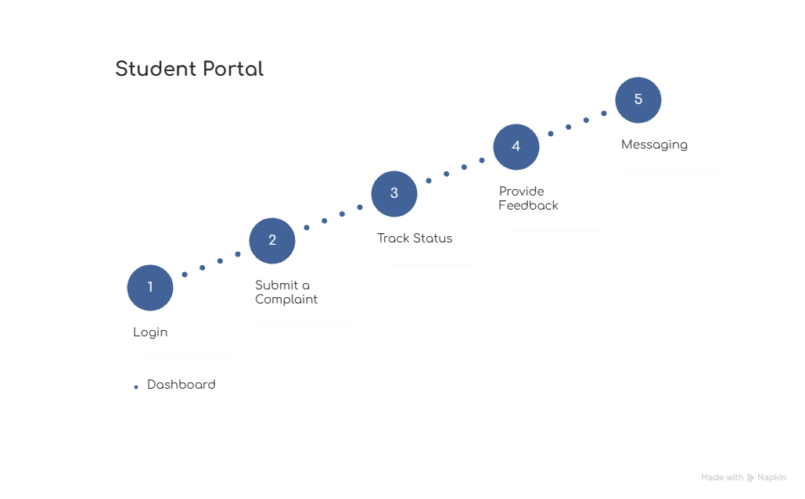
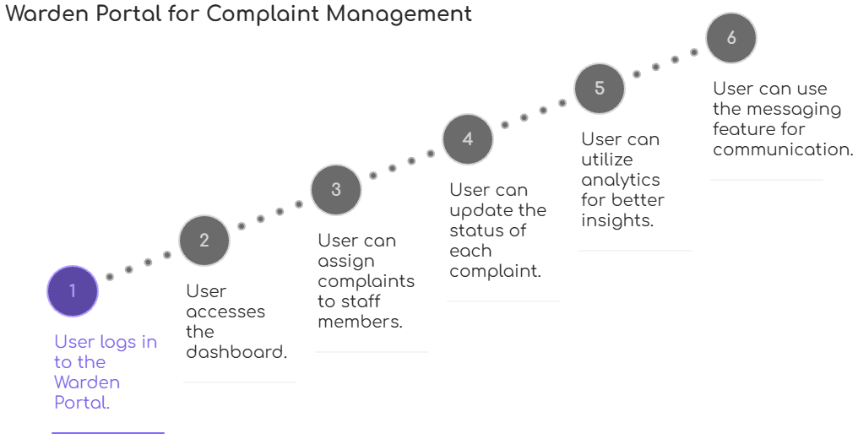
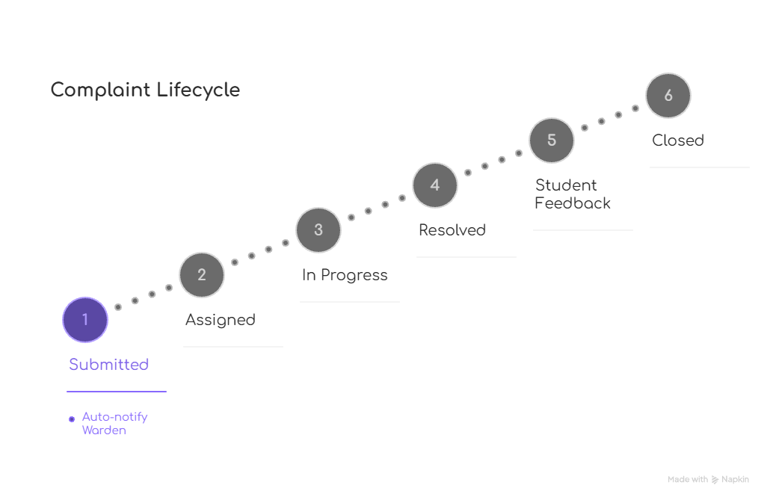
Technical Details
Technologies to be used: • Frontend: HTML5, CSS3, JavaScript (Vanilla) • Charts & Visualization: Chart.js for analytics • Icons & UI: Font Awesome for icons • Database: LocalStorage/IndexedDB for client-side data storage • Deployment: Any static web hosting (GitHub Pages, Netlify, Vercel) • Version Control: Git for collaboration
Methodology and process for implementation:
System Architecture:
User Authentication Layer: Role-based login (Student/Warden/Staff)
Data Management Layer: LocalStorage with JSON structure
Application Layer: Separate HTML pages for each functionality
Presentation Layer: Responsive CSS with modern UI
Page 3

Slide 4
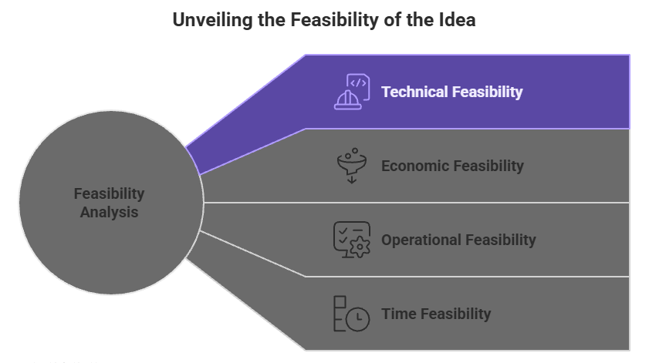
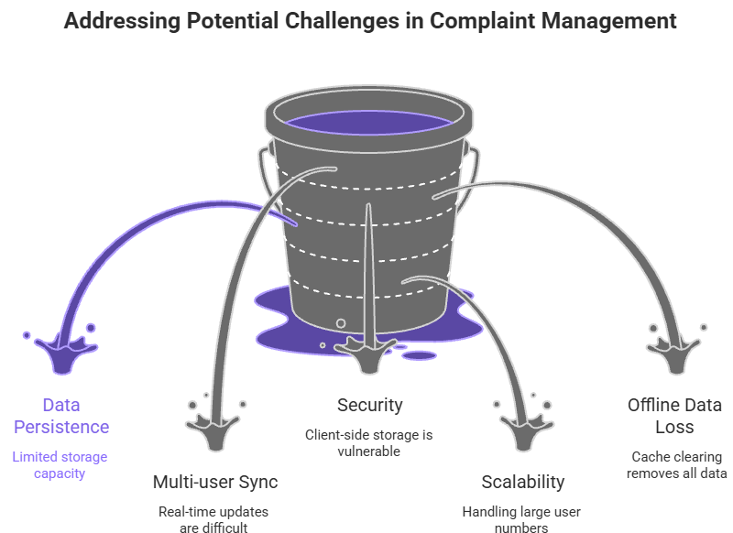
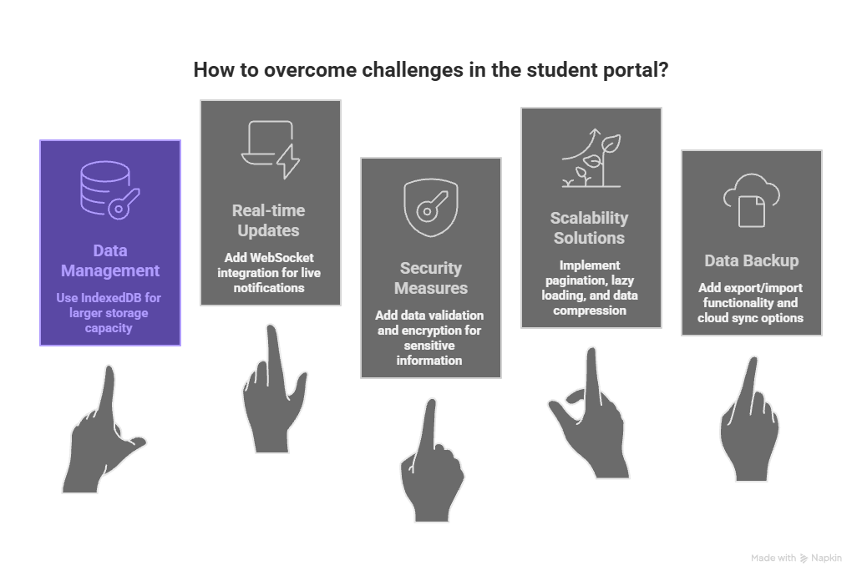
Feasibility & Viability
Page 4

Slide 5
Impacts & Benefits
Potential impact on the target audience: • Students: Faster complaint resolution, transparent tracking, better communication • Wardens: Efficient task management, performance monitoring, reduced paperwork • Maintenance Staff: Clear assignments, priority guidance, accountability tracking • Hostel Administration: Data-driven decisions, resource optimization, improved satisfaction
Social Benefits: • Improved student satisfaction and hostel living experience • Transparent communication reduces conflicts and misunderstandings • Efficient resource allocation benefits entire hostel community
Economic Benefits: • Reduces administrative overhead and paperwork costs • Minimizes maintenance delays preventing larger repair costs • Optimizes staff utilization through workload balancing
Operational Benefits: • Digital tracking eliminates lost complaint records • Analytics identify recurring issues for preventive maintenance • Standardized workflow ensures consistent service quality
Environmental Benefits: • Paperless system reduces environmental footprint • Efficient maintenance prevents resource wastage • Digital communication reduces physical travel needs
Page 5

Slide 6
Research & References
Details / Links of the reference and research work :
https://chat.deepseek.com/share/8nov6gp2idrc1egchs
Design Links :
https://www.figma.com/make/N3xdwPdoQf56K4ZNjmfk06/Hostel-Complaint-Management-System?t=8ietC087AsHb4uy9-1
Research & References:
Competitive Analysis: Studied existing hostel management software and their limitations
Best Practices: Applied Material Design principles and accessibility guidelines (WCAG 2.1)
Technical References:
MDN Web Docs for LocalStorage implementation
Chart.js documentation for analytics visualization
Font Awesome for icon system
Industry Standards: Followed ITIL framework for incident management workflows
Future Enhancements:
Mobile application with push notifications
AI-powered complaint categorization and routing
Predictive maintenance scheduling based on analytics
Integration with IoT sensors for automated issue detection
Multi-language support for diverse student populations
Deployment Plan:
Phase 1: Basic complaint tracking system (Current Implementation)
Phase 2: Mobile app with push notifications
Phase 3: IoT integration for automated maintenance requests
Phase 4: Predictive analytics for preventive maintenance
Page 6

